Slide 1
PLANNING SLIDE
Player
Role at the table (Player vs DM)
DM
Job of the DM
Running a Game
Session Zero
Worldbuilding
Online Play
Phases of Play (Action/Bonus/Movement)
Play Style
Melee/Range/Caster/Support
Game Style (Gritty Realism, Sarcasm, Humor, Heavy Combat, Political, Urban)
Party Play vs Person Play
Before the Table - How should it go
After the Table - How did it actually go
Know your game - not just the monsters - but the players too
At the Table - How is it going
House Rules
Setting the stage
Moving the action
Start simple
Start Simple
Start Small
Start with what you know
Make it possible
Resources
Hooks
Referee
Narrator
Memory
D&D Beyond
Kobold Fight Club
Roll20
Token Maker
Google Images
Lost Atlas lostatlas.co

Slide 2




Learn to Play D&D
Friday
Learn to be a Dungeon Master
Saturday
Worldbuilding for D&D
Saturday
Running the Game and Campaign
Sunday
Using Online Tools to Play D&D
Sunday
7:30pm
11:30 am
1:30 pm
12:30 pm
2:30 pm
https://github.com/majornerd/dragonfodder
Notes:
https://github.com/majornerd/dragonfodder

Slide 3
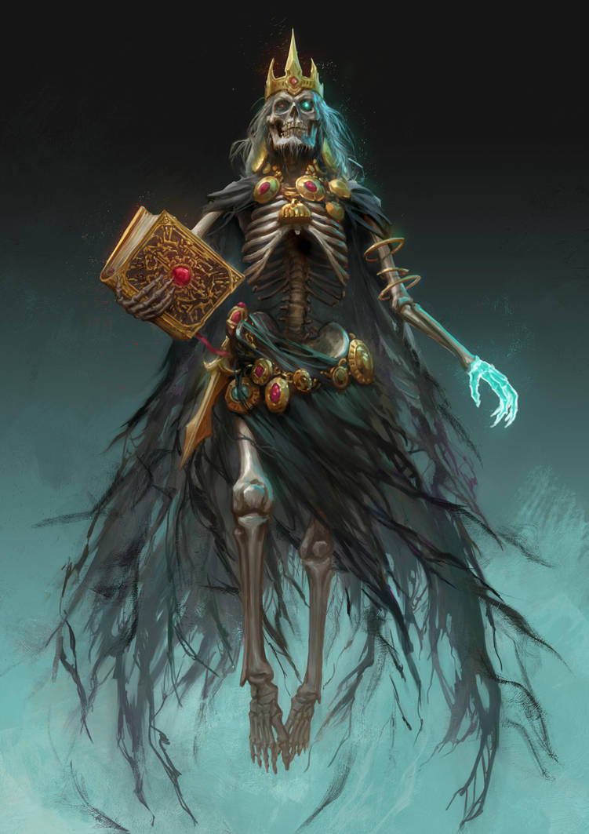
Welcome to Dragon Fodder
We will start from zero, no experience required
Participation will be rewarded
We have gifts
Targeted for Beginners, enough content that experts should have a take away or two

Slide 4
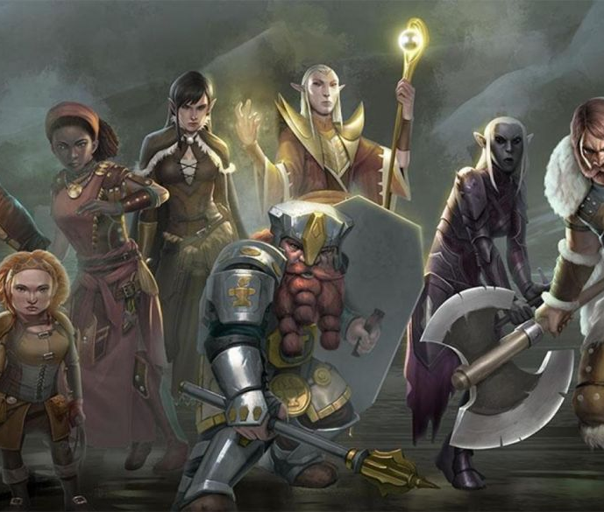
Who is Dragon Fodder?
Howard – DM – 35yrs (DM for 35yrs)
Darrel – DM – 45 yrs (DM for 5)
Jennifer – Player – 5 years of Play (4e & 5e)
Scott – Player & Pro Presenter – 3 years of Play
Chadd – Player – 1.5 years of play

Slide 5

It’s PARTY play, NOT "person" play

Slide 6

Dungeons and Dragons is a game of communal storytelling

Slide 7
Game Creation
D&D Beyond is your Friend
Create the Campaign
Share the relevant sourcebooks
Define House / Game Rules
How are you going to roll abilities
What House Rules
Share your hook on the campaign page

Slide 8
Character Creation
20 questions
What do you look like
How do strangers see you
What was your upbringing
Are you still in contact with people from your childhood
Why did you become an adventurer
Where have you been already
Do you believe in the Gods? Do you follow one?
How do you feel about Magic?
What is worth dying for?
20Q Cont’d
What is your dream?
What is your stance on morals or the law
How do you deal with strangers?
How do you place a value on a person's life? Animals?
Do you see all races as the same?
Does your hero like arts?
What’s your favorite meal?
What about love?
Do you have a dark secret?

Slide 9
Session Zero
Session Zero is a critical “Pre-game” session
Goals of Session Zero:
Character Creation
Align player goals
Provide background on the game world
Scheduling
Party make up
House Rules

Slide 10
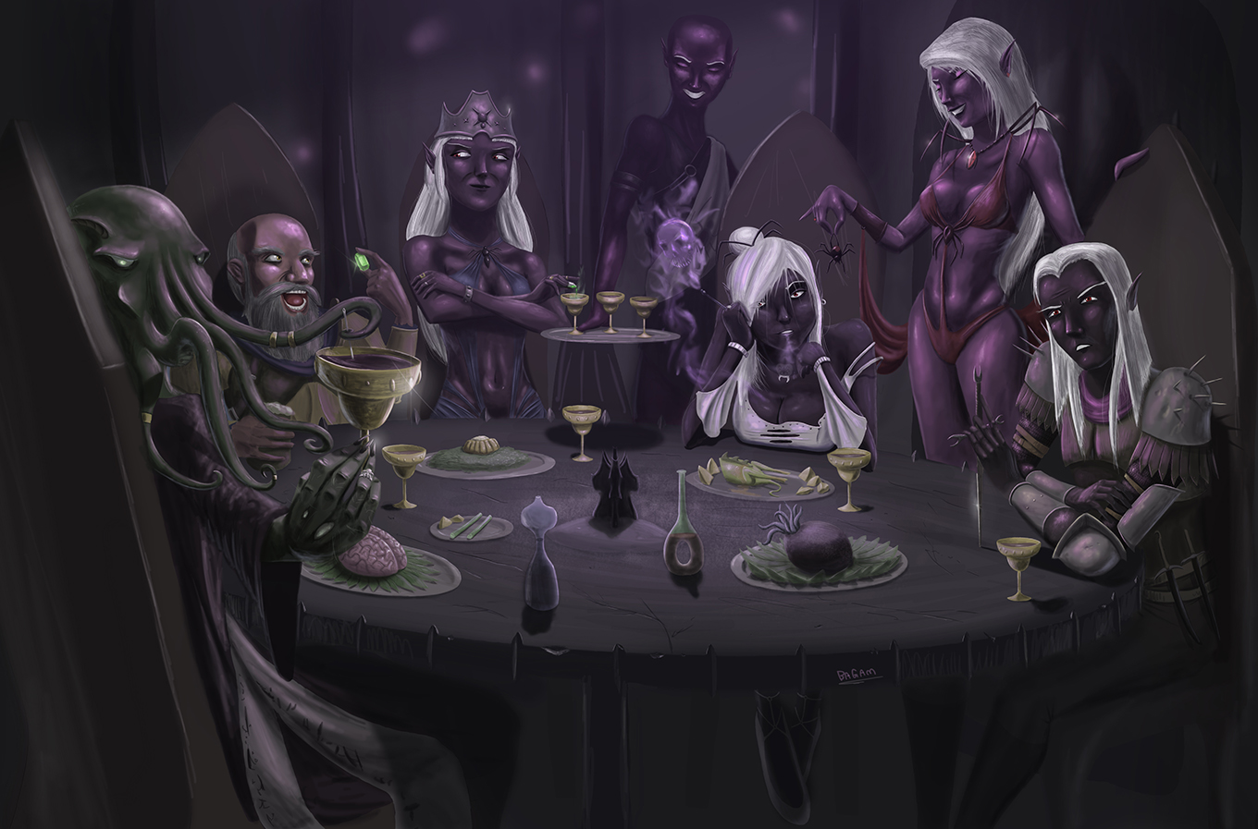
Running the Game
Relax
Focus on your Strong Start
Listen to the players and build off what they bring

Slide 11
Running the Game
Trust your preparation to help you run a creative AND flexible game
Imagine the world as a living place
Story cycles are critical, so balance action with relaxation building and releasing tension

Slide 12

Running the Game
The dice build tension, use them accordingly
The players drive the action, make the world react to them, not the other way around
Use a mixture of combat styles, including theater of the mind, gridded maps, and abstract maps

Slide 13
Running the Game
Ask the players to summarize the prior session
Draw players into the story by asking them to describe the action; reward them when they do, do NOT penalize them when they don’t
Maintain a good pace by keeping the action close

Slide 14
Running the Game
Sometimes a chair is just a chair, but never if the DM says it is a chair

Slide 15
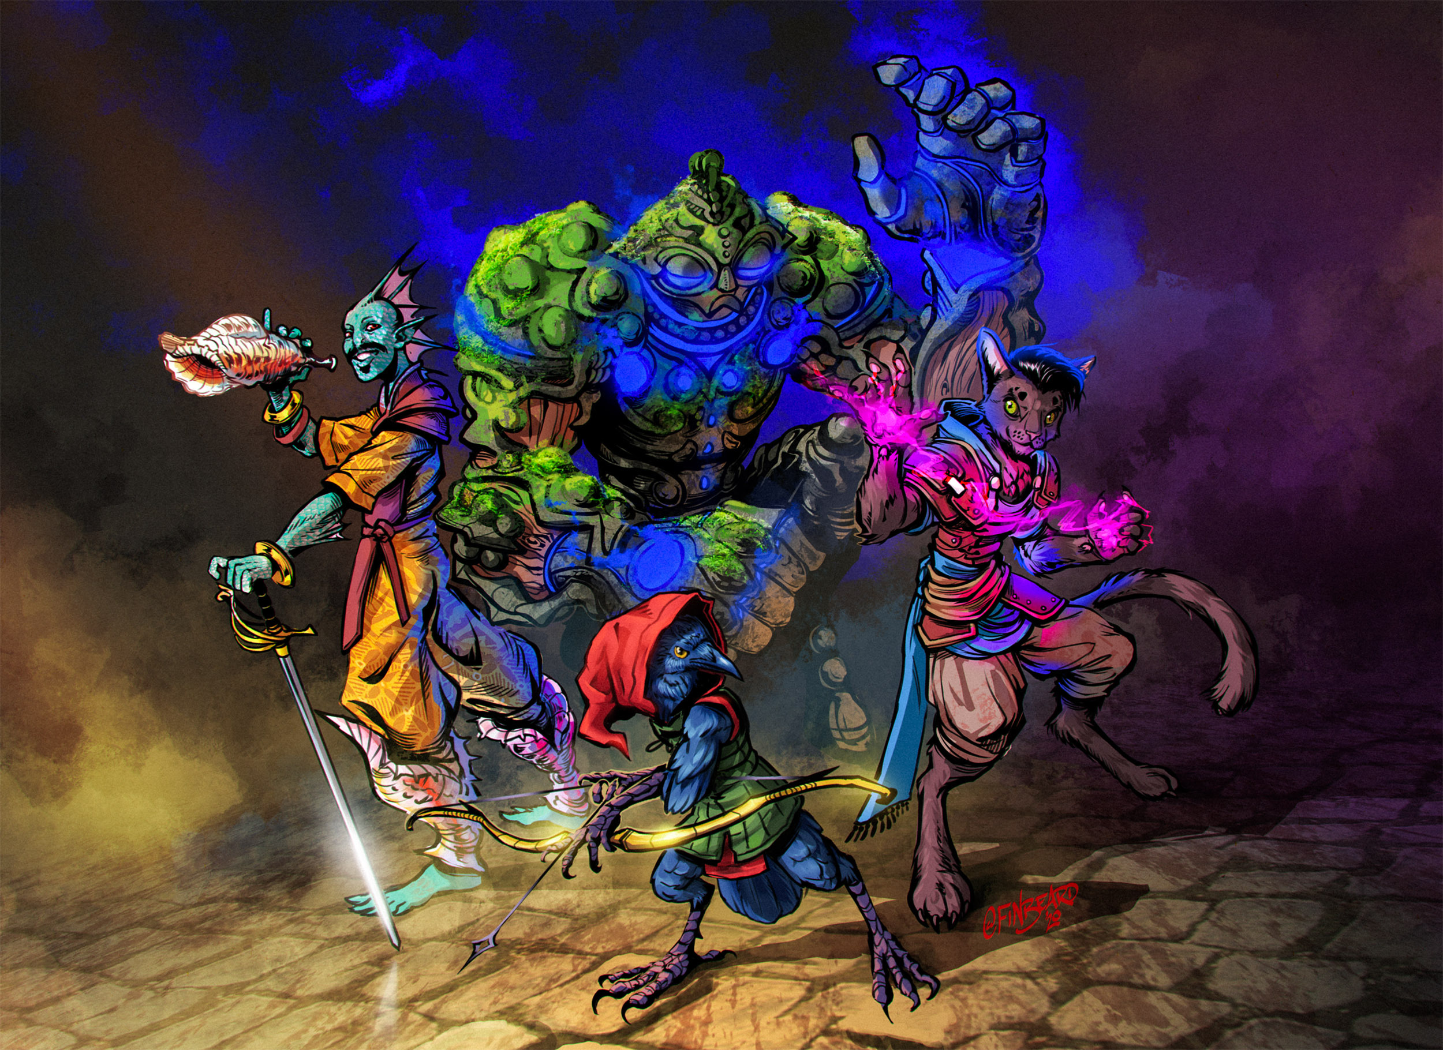
Building the Campaign
Run a Session Zero to help build the characters and tie them together
This Photo by Unknown Author is licensed under CC BY-NC-ND

Slide 16
Reskin Published Material
This Photo by Unknown Author is licensed under CC BY-NC-ND

Slide 17
Building the Campaign
Hook based on a single major goal
This Photo by Unknown Author is licensed under CC BY-NC-ND

Slide 18
Building the Campaign
Develop a Spiral Campaign with the Players at the Center
Hook based on a single major goal
State the Six Truths of your Campaign
Define Three Fronts Incorporating goals and grim portents
Run a Session Zero to help build the characters and tie them together
This Photo by Unknown Author is licensed under CC BY-NC-ND

Slide 19
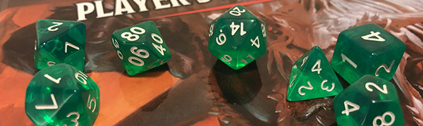
Rule #X: Steal When You Can
It is unlikely you are the first to be in this situation, the magic of Google can often provide a quick solution.
This Photo by Unknown Author is licensed under CC BY-SA-NC

Slide 20
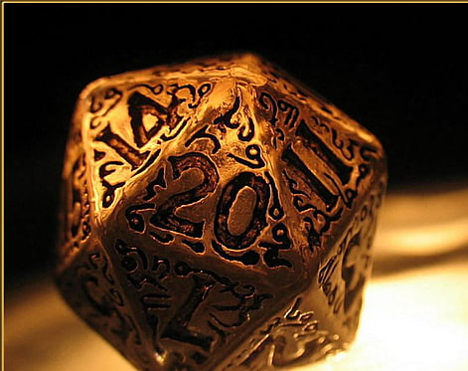
Rule #X: Perfection is the Enemy of Progress
When you are at the table, aim for “good enough” to move the game forward. Once the session is over, reflect and adjust. Use your session recap to announce the changes that your learning has provided.

Slide 21

Rule #X: The DM’s role is that of the Narrator and the Referee
It is NEVER you vs the players. You are NOT the BBEG, the King, the Dragon, etc.
Your job is to create tension that the players can overcome and celebrate with them when they do.
Help your players follow Ted Lasso’s Rule #1: Be a Goldfish

Slide 22
Rule #X: Let the Story Unfold at the Table
The DM brings the locations, situation, NPC’s, enemies, to the table. The players bring the motion ….. And the chaos.
Trying to play your story out won't be fun for anyone, even if you think it will be.
Let the chaos play. Chaos is where all the good stories reside.

Slide 23
Rule #X: Set the Situation and let it run
Once you setup the situation, let the players run with it. Take pleasure and joy in what they make of the building blocks you laid at their feet.
You only really have to take a hand when they are stalled in the action.
Keep some quick things you can use to “spike” the players with and jump start some action.

Slide 24
Rule #X: Help the Players find their Character
Characters are just numbers on a sheet until we bring them to life. This is not a skill that comes easy to everyone. The best DM’s help their players find who their characters are, what makes them tick and what gives them motivation.
Take some time to help your players move out of their comfort zone, or move away from the easy tropes.
Don’t try to do it all at once, but over time. Baby Steps

Slide 25
Rule #X: The Enemy is Motivated – Play It
Nothing that is evil believes itself to be evil. The greatest villain's tug at some part of us that wants to agree, then pushes a little too far.
The enemies don’t want to die
The King doesn’t want to be deposed
The Lich firmly believes they are right and just
Enemies WILL run away

